Slide 1
NPTEL MOOCs course on
Phonetics and Phonology:
A Broad overview
Shakuntala Mahanta
Department of Humanities and Social Sciences
Indian Institute of Technology Guwahati

Slide 2
Unit 2
Acoustic Phonetics

Slide 3
Brief Recap
Sound is variation in air pressure
Detectable by the human ear

Slide 4
Acoustic phonetics: Sound waves
Sound Wave
Transmission of energy
Compression and rarefaction
Through a medium

Slide 5
Acoustic phonetics: Sound waves
Acoustic phonetics: Sound waves
What type of a wave is a sound wave?
Mechanical waves
electromagnetic waves

Slide 6
Acoustic phonetics: Sound waves
Sound waves are mechanical waves,
Medium
Air

Slide 7
Resonators and Filters
Different vibrating objects are tuned to specific frequencies
natural frequency – the frequency at which a particular object prefers to vibrate
Resonance - when the frequency of the external force is near to the natural frequency of the vibrating system.

Slide 8
Resonators and Filters
Result - amplitude of vibration increases at natural frequencies, so the latter works as a resonator.
amplitudes at other frequencies are attenuated or increased
So the driven system functions as a modifier or a filter

Slide 9
Resonators and Filters
Filtering of a complex sound is the process of selection
some frequencies are allowed to go through the filtering while other frequencies are blocked.
There are different kinds of filters.

Slide 10
Acoustic phonetics: Sound waves
Series of band pass filters create a visual representation of sounds - spectrograms.
Spectrograms display time on the horizontal axis
frequency on the vertical axis
while amplitude is represented by means of colour.

Slide 11
Acoustic phonetics: Sound waves
Depending on the use of broadband or narrowband filters, we can get either wide-band (typically 300 Hz bandwidth) or narrow-band (45 Hz bandwidth) spectrograms.

Slide 12
Three types of representation
Spectrum
the amplitudes of the different harmonics
Wave Form
How sound pressure varies over time
Specrogram
A spectrogram is a visual representation of the spectrum of frequencies of a signal as it varies with time.

Slide 13
Acoustic phonetics: Sound waves
In a wide-band spectrogram individual harmonics are suppressed
it is possible to see individual voicing pulses as vertical striations.
They are most commonly used because in majority of cases we are not interested in the changes of harmonics.

Slide 14
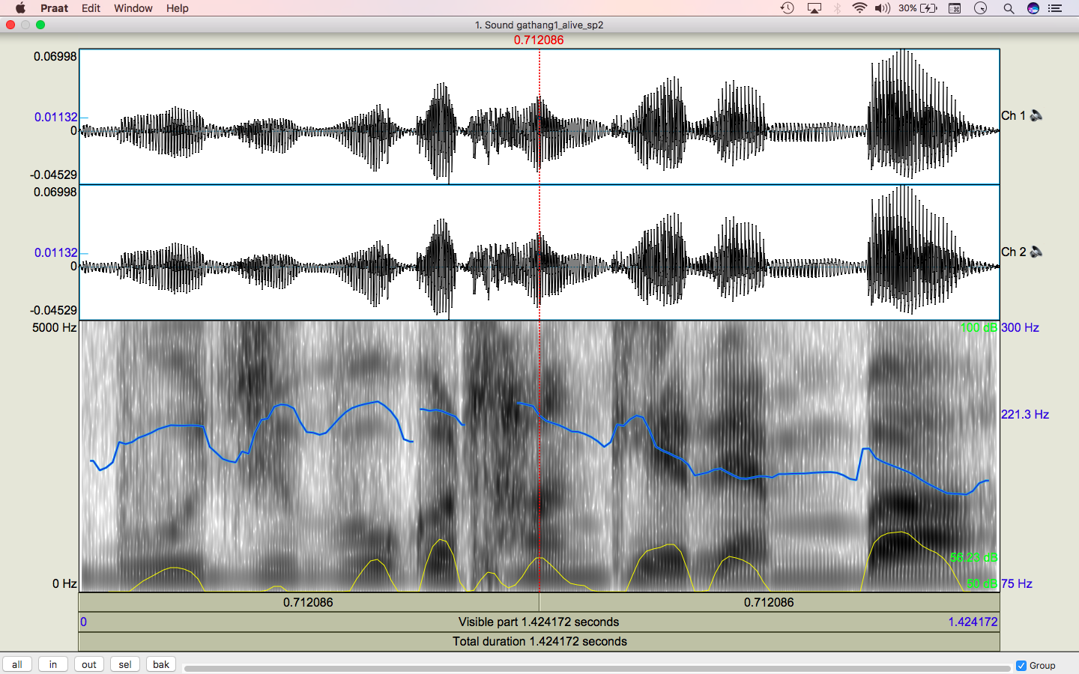

Slide 15
Fourier analysis on the glottal source waveform gives us the power spectrum showing its component frequencies.
Amplitude of harmonics decrease rapidly as frequency increases

Slide 16
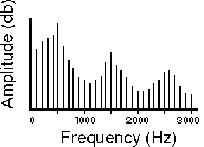

Slide 17
Acoustic phonetics: Sound waves
Source-Filter Theory
sound production consists of two basic parts:
generation of sound source at the glottis
(2) filtering of that source by the vocal tract.

Slide 18
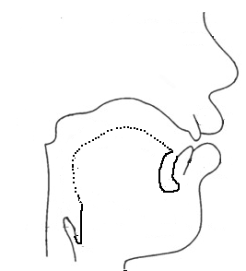
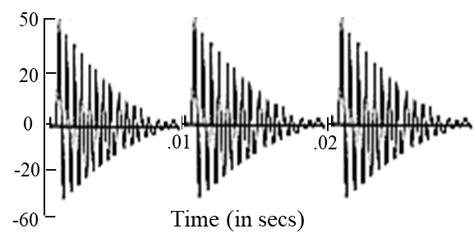
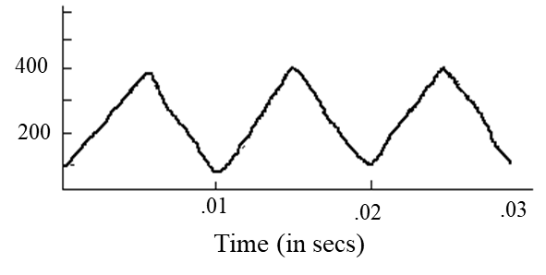

Source filter theory
Output from lips
Glottal airflow
=
Vocal tract filter function
(F0 filtering)

Slide 19
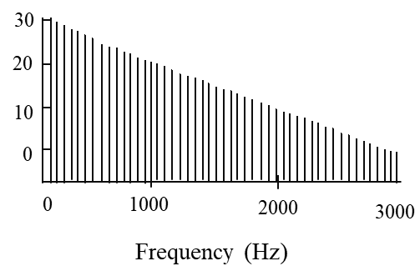
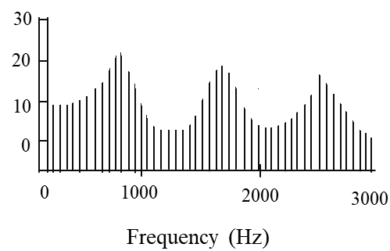
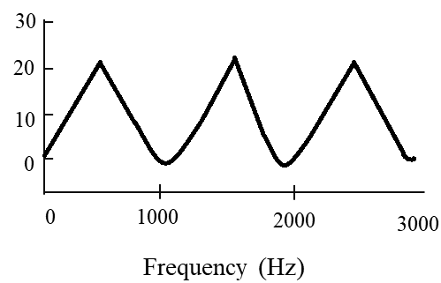
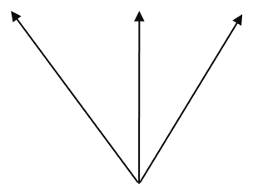
Source filter theory
Source spectrum
Resonance
Output spectrum
Formants frequencies
Vocal tract filter function
(F0 filtering)

Slide 20
There are two types of sound sources involved in speech production:
Periodic glottal voicing source
Aperiodic source

Slide 21
Acoustic phonetics: Vowels
Vowel sounds are quasi-periodic sound waves.
The frequency components of a complex periodic wave are called harmonics.
The lowest harmonic is fundamental frequency (f0).
Higher harmonics – also called overtones
Integer multiples of the fundamental frequency.

Slide 22
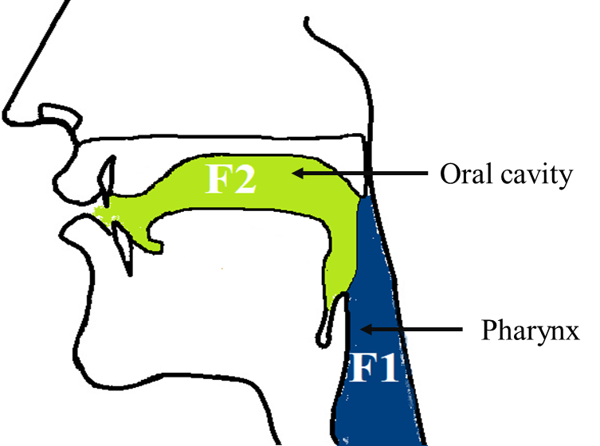
Formants

Slide 23
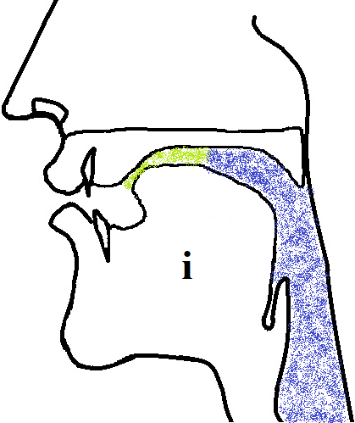
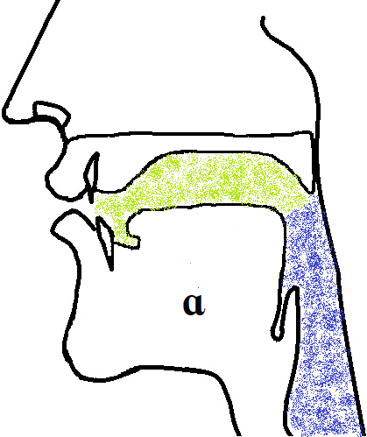
Formants
Oral cavity
F2
Pharynx
F1
Oral cavity
F2
Pharynx
F1
Different resonance chambers and different vowel use for F1 and F2

Slide 24
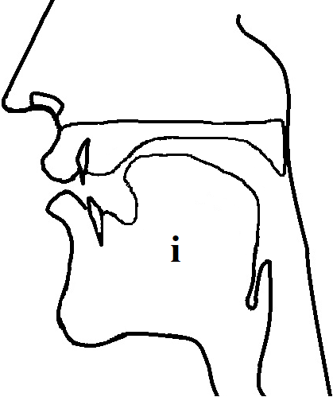
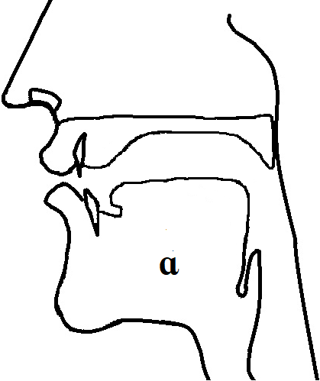
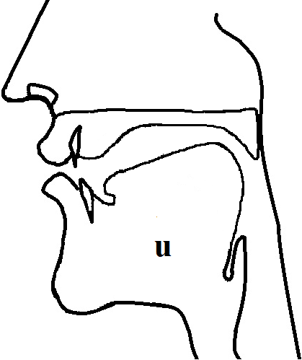
Source filter theory
Different vocal tract shapes lead to different frequencies

Slide 25
Vowels
Vowels are the product of glottal periodic source and filtering in the supraglottal tract.
When vocal folds vibrate, the rate of air flow through the glottis results in a complex periodic wave.

Slide 26
f0 of the vocal fold vibration is dependent on several factors
Typical average values for f0 are as follows:
adult males voice: 125 Hz
adult female voice: 220 Hz
child’s voice: 300 Hz

Slide 27
Vocal tract filter selectively passes energy in the harmonics of the source.
Characteristic resonances of the vocal tract are called formants (F1, F2, F3 etc).
The vocal tract transfer function for a particular vowel is defined by the centre frequency and bandwidth of these formants.

Slide 28
We can model the acoustic properties of the vocal tract as a tube open at one end (mouth) and closed at the other (glottis).
If this tube is uniform in its cross-section – as in the production of a schwa, we can compute the resonant frequencies of that tube

Slide 29
Fn = (2n – 1)c/4L where n is the number of the formant and L is the length of the tube.
This formula derives formants for tubes with uniform cross-sectional area

Slide 30
In the production of a vowel the vocal tract is closed at the glottis and open at the mouth.
Although the glottis is periodically opening and closing, the openings are almost negligible

Slide 31
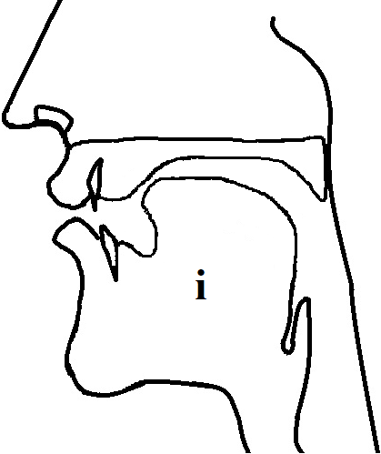
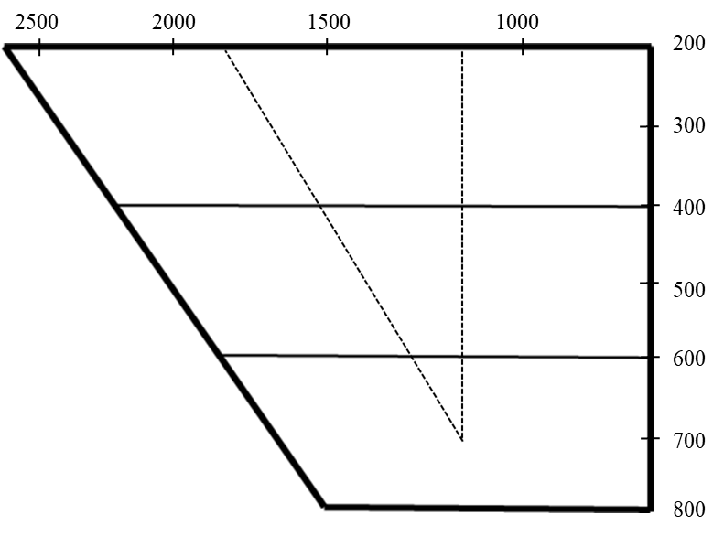
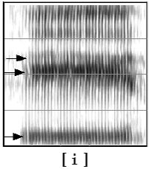

British English Vowels
F2
4000
●i
3000
2000
F1
1000
Hz
Fig. 1. Formant chart plotting F1 & F2, vocal tract diagram, and spectrogram for the vowel [i]

Slide 32
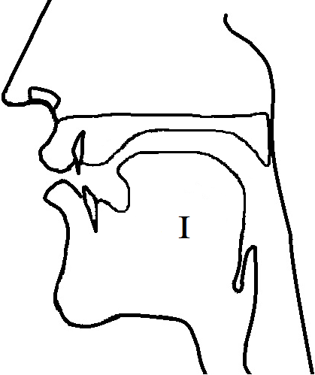
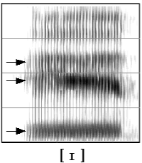
British English Vowels
F2
4000
3000
●ɪ
2000
F1
1000
Hz
Fig. 2. Formant chart plotting F1 & F2, vocal tract diagram, and spectrogram for the vowel [ɪ]

Slide 33
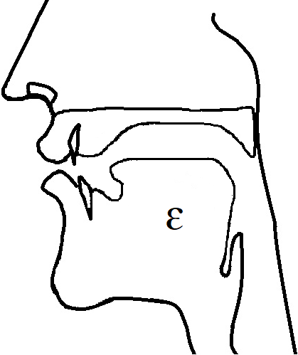
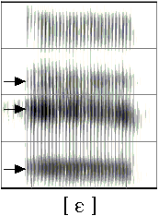
British English Vowels
F2
4000
3000
2000
ɛ●
F1
1000
Hz
Fig. 3. Formant chart plotting F1 & F2, vocal tract diagram, and spectrogram for the vowel [ɛ]

Slide 34

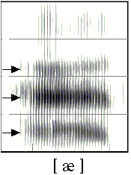
British English Vowels
F2
4000
3000
2000
F1
1000
æ●
Hz
Fig. 4. Formant chart plotting F1 & F2, vocal tract diagram, and spectrogram for the vowel [æ]

Slide 35
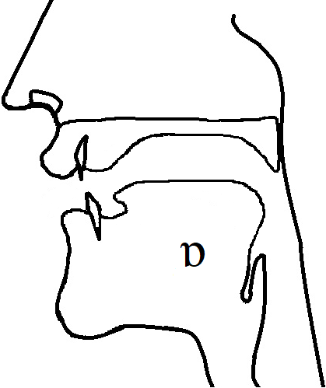
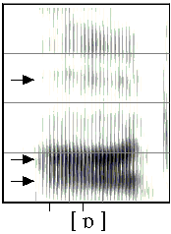
British English Vowels
F2
4000
3000
2000
F1
1000
ɒ●
Hz
Fig. 5. Formant chart plotting F1 & F2, vocal tract diagram, and spectrogram for the vowel [ɒ]

Slide 36
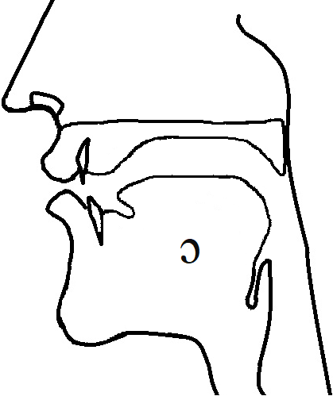
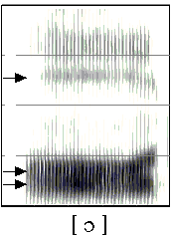
British English Vowels
F2
4000
3000
2000
●ɔ
F1
1000
Hz
Fig. 6. Formant chart plotting F1 & F2, vocal tract diagram, and spectrogram for the vowel [ɔ]

Slide 37
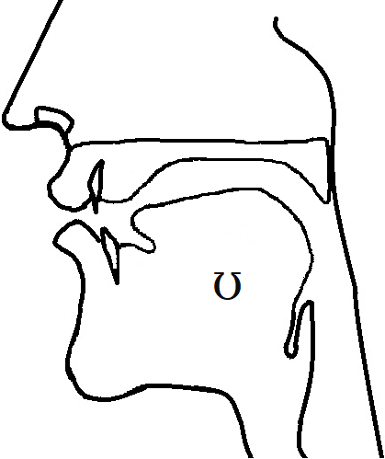
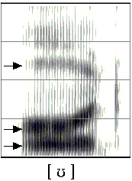
British English Vowels
F2
4000
3000
●ʊ
2000
F1
1000
Hz
Fig. 7. Formant chart plotting F1 & F2, vocal tract diagram, and spectrogram for the vowel [ʊ]

Slide 38
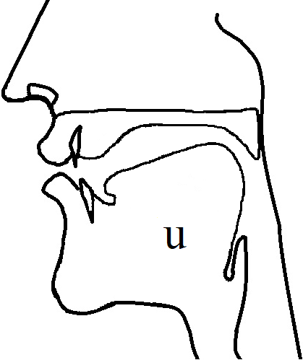
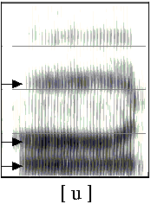
British English Vowels
F2
4000
●u
3000
2000
F1
1000
Hz
Fig. 8. Formant chart plotting F1 & F2, vocal tract diagram, and spectrogram for the vowel [u]

Slide 39
First formant frequency (F1) is referred to as the frequency of the pharyngeal or back cavity.
F1 is inversely related with tongue height:
low vowels have high F1 and high vowels have low F1.

Slide 40
The size and length of the oral/front cavity are the main factors determining second formant frequency (F2).
front vowels have high F2 while back vowels have low F2
the formant frequencies decrease through the cardinal vowels.

Slide 41
There is also of lip rounding, which always lowers all frequencies
[ɑ] is back than [u] but has higher F2.
Lip rounding and retroflexion of the tongue cause lowering.

Slide 42
The differences in the waveform –
time that the vocal folds are open during each glottal cycle.
The relationship between amplitudes of the first two harmonics
and
slope of the spectrum are two main spectral indicators of the type of phonation

Slide 43
Glottal source waveform and spectrum vary depending on the type of phonation –
Modal
Creaky
breathy

Slide 44
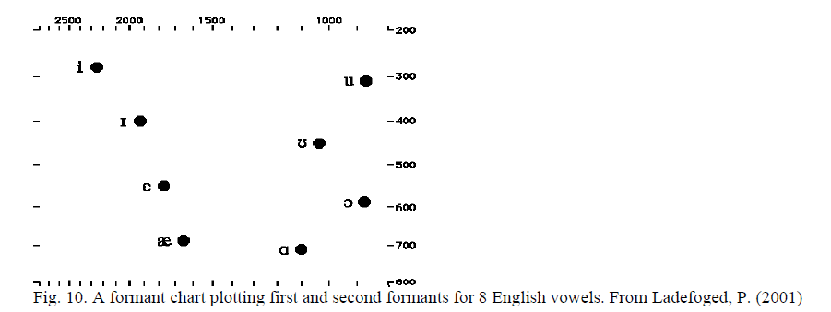

Slide 45
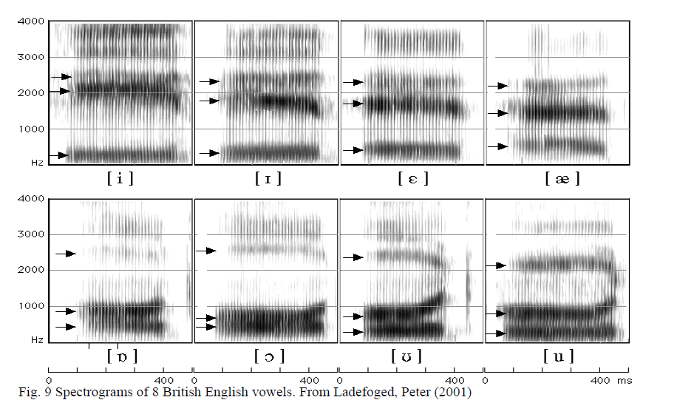

Slide 46
These sources may be combined, e.g. production of voiced fricatives involves both periodic laryngeal source and aperiodic noise generated in the vocal tract.

Slide 47
Production of voiced stops combines all three sources.
Alone or in combination, these sources serve as input for the vocal tract filter which modulates this input, as different frequency components of the source are passed through the filter.

Slide 48
Acoustic properties of nasals, liquids and glides Nasals and liquids share periodic glottal source with vowels. But their filtering effects are more complicated. Vocal tract filtering effects for vowels were modelled as resonances of coupled tubes, each of which was open at one end.

Slide 49
Nasals and laterals are characterized by the presence of a side branch, i.e. a closed tube. During the production of nasal consonants, the velum is lowered so that the pathway from the pharynx to the nasal passages is open and air flows from the lungs out through the nostrils. In nasal stops, the mouth cavity is closed off by a complete constriction in the vocal tract.

Slide 50
Other characteristic properties of nasals include: (i) low F1 (sometimes called N1 or nasal murmur), typical figures 250-300 Hz, as a result of increase in overall length of the filtering tract; (ii) formants are much weaker than in vowel sounds, i.e. the peaks are lower in amplitude due to the fact that soft mucous membranes of nasal cavity absorb sound.

Slide 51
The release burst is very brief transient noise which has a flat spectrum. Irrespective of other variations, bursts tend to show a strength hierarchy: voiceless aspirated > voiceless unaspirated > voiced. i.e. burst spectrum of voiceless stops has more energy than that of voiced stops. The source spectra for aspiration and frication are nearly the same as for fricatives.

